Slide 1
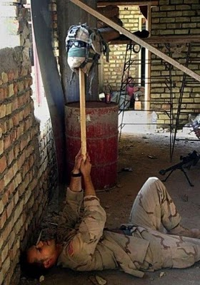
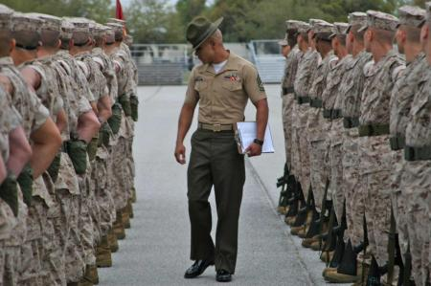
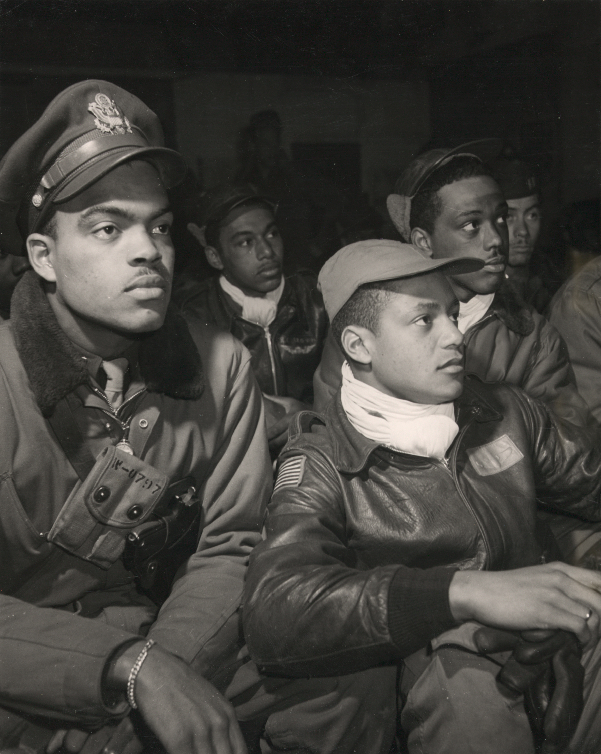
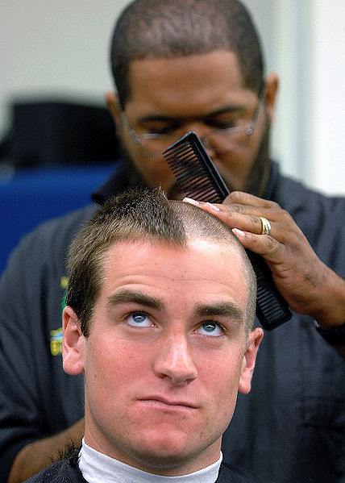
Military Culture
Week One

Slide 2
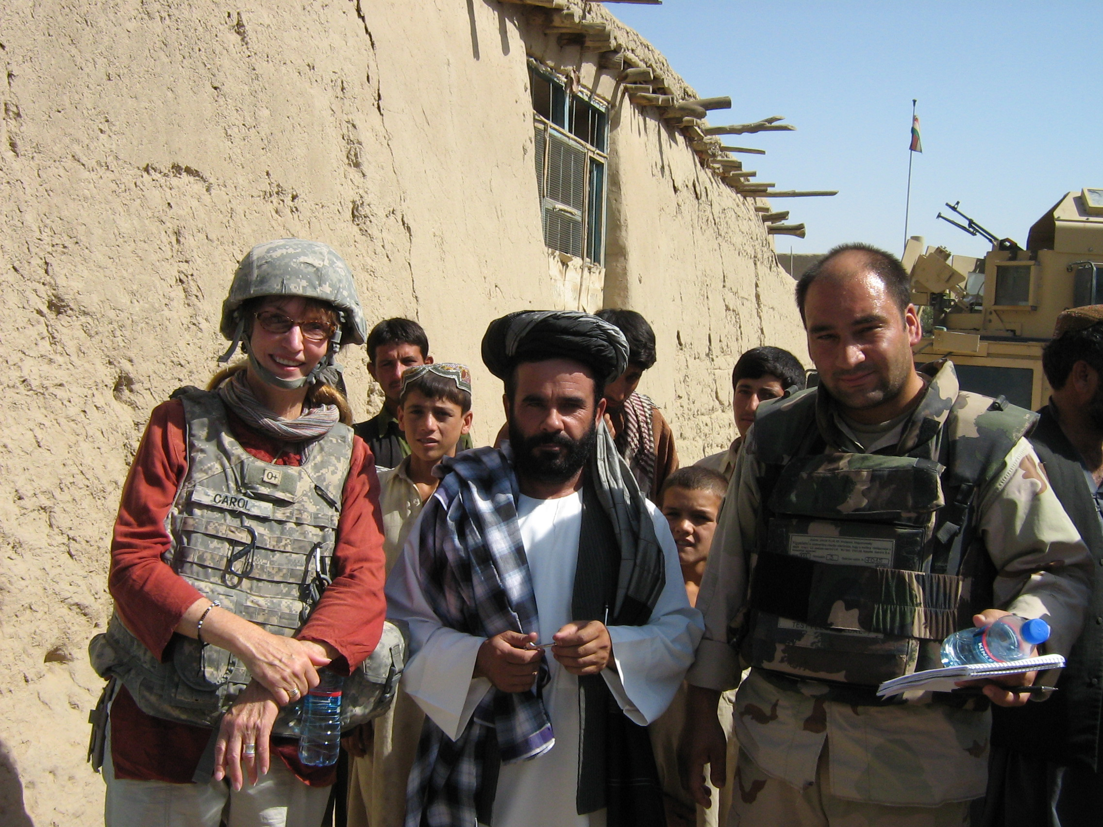
Carol Burke

Slide 3
These closely related fields share a concern for group and an interest in the common exchanges and practices that function like a centripetal force to hold the group together.
Folklore
Ethnography
ethnos – a group of people who share a common culture
graph – to write
Ethnographic Journalism (sometimes called “immersion journalism”)

Slide 4
Popular misconceptions about folklore
That it’s always untrue
That it’s dying out
That it’s the province of the illiterate

Slide 5
Ben Botkin’s description of folklore
“Every group bound together by common interests and purposes, whether educated or uneducated, rural or urban, possesses a body of traditions which may be called its folklore. Into these traditions enter many elements, individual, popular, and even “literary,” but all are absorbed and assimilated through repetition and variation into a pattern which has value and continuity for the group as a whole.” (Manual for Folklore Studies, 1938)

Slide 6
Categories of Folklore
Speech: slang, jokes, sayings, nicknames
Narrative: legends, urban legends, fairy tales, folk tales, personal experience narratives (which, hopefully, you’ll be collecting in the interview that you’ll be doing)
Music: traditional tunes as well as a group’s adaptation of popular tunes
Expressions of Belief: superstitions, home altars
Ritual: holiday dinners, initiation rites, funerals weddings, quinceaneras, bar (or bat) mitzvahs, New Year’s celebrations
Material Culture: functional or decorative objects or their modification

Slide 7
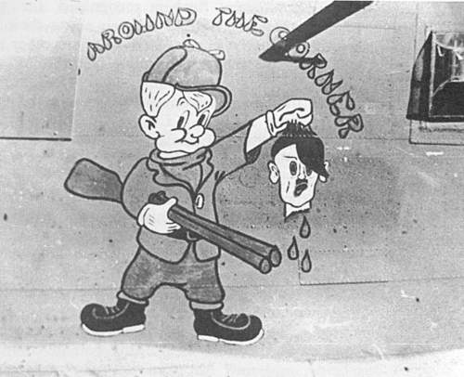
Material Culture: Nose Art

Slide 8
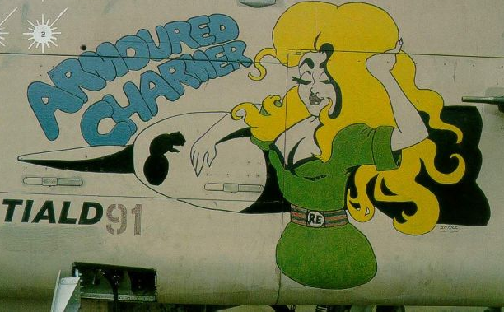
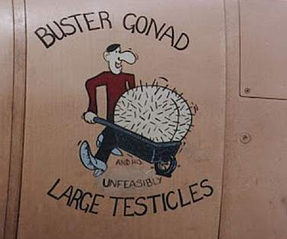

Slide 9
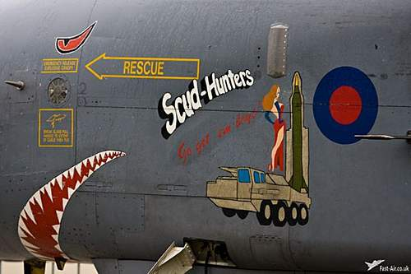
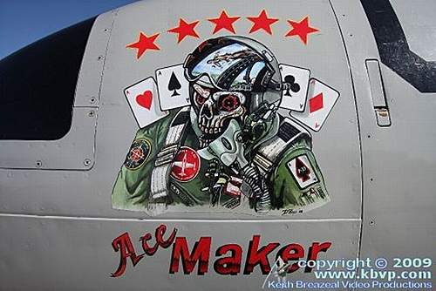
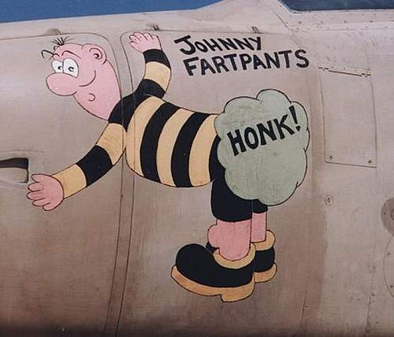
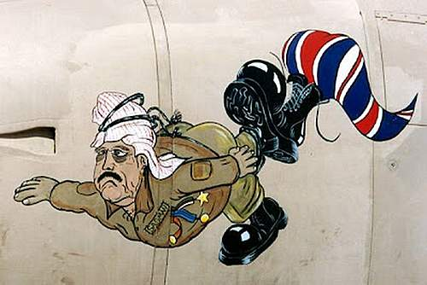
RAF
RAF
RAF

Slide 10
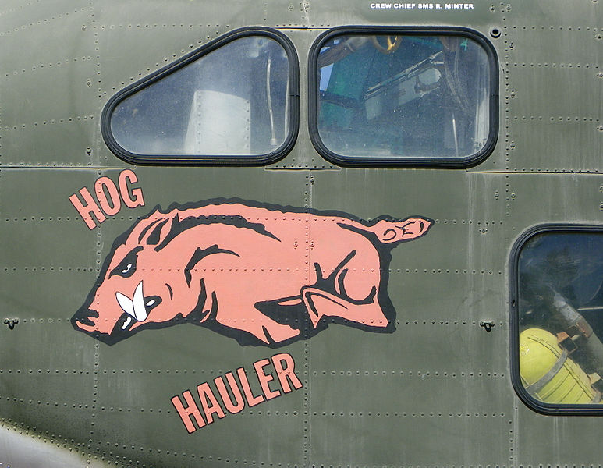
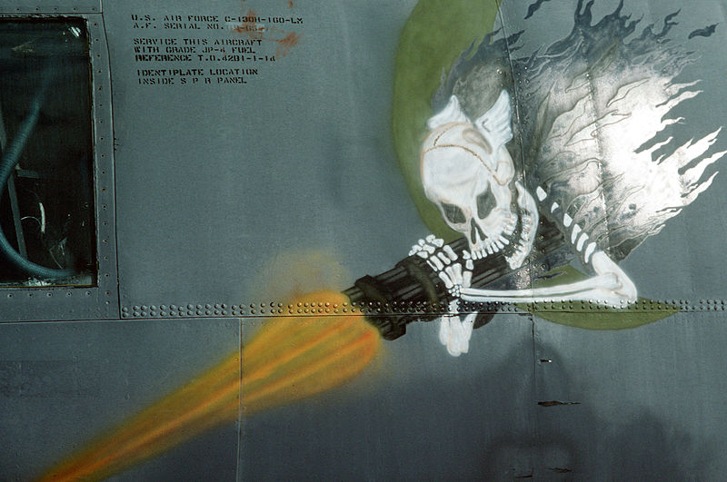
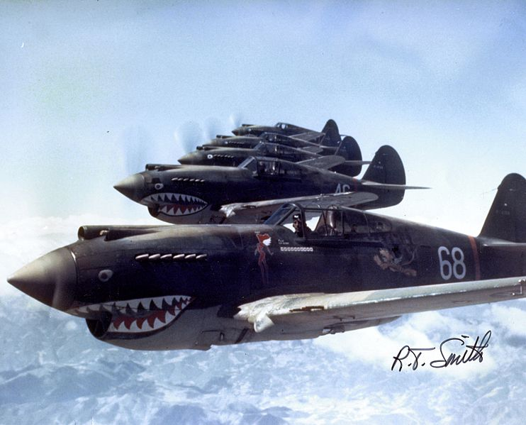
Nose art

Slide 11
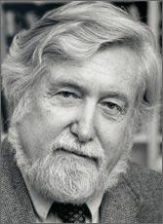
Clifford Geertz
“thick description”
A combination of detailed
observation and
contextual analysis

Slide 12
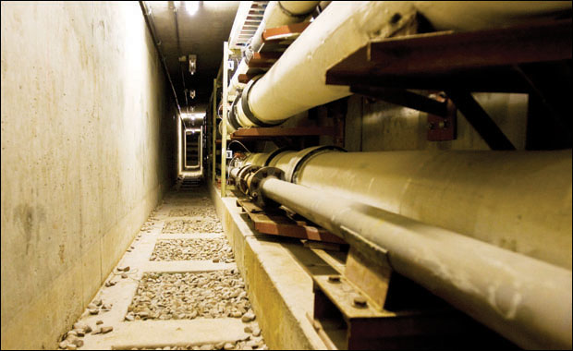
Underground tunnels

Slide 13
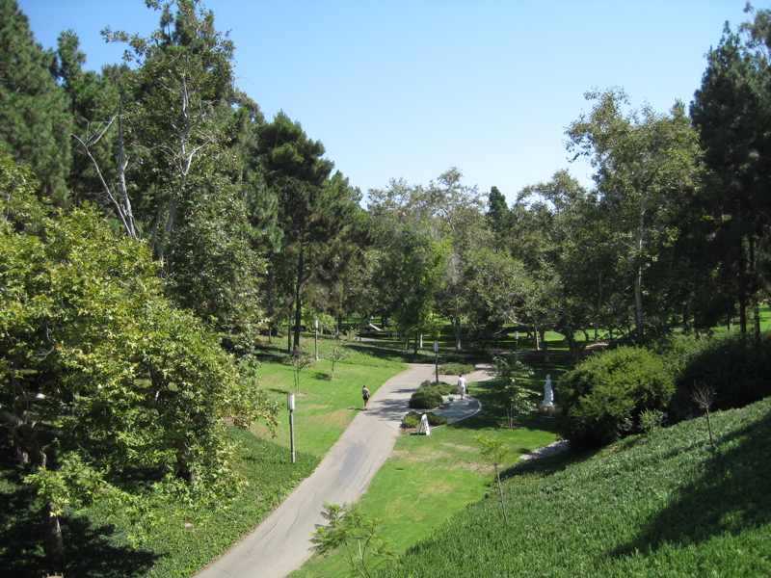
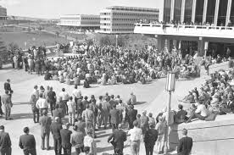
Aldrich Park

Slide 14
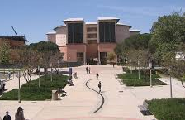
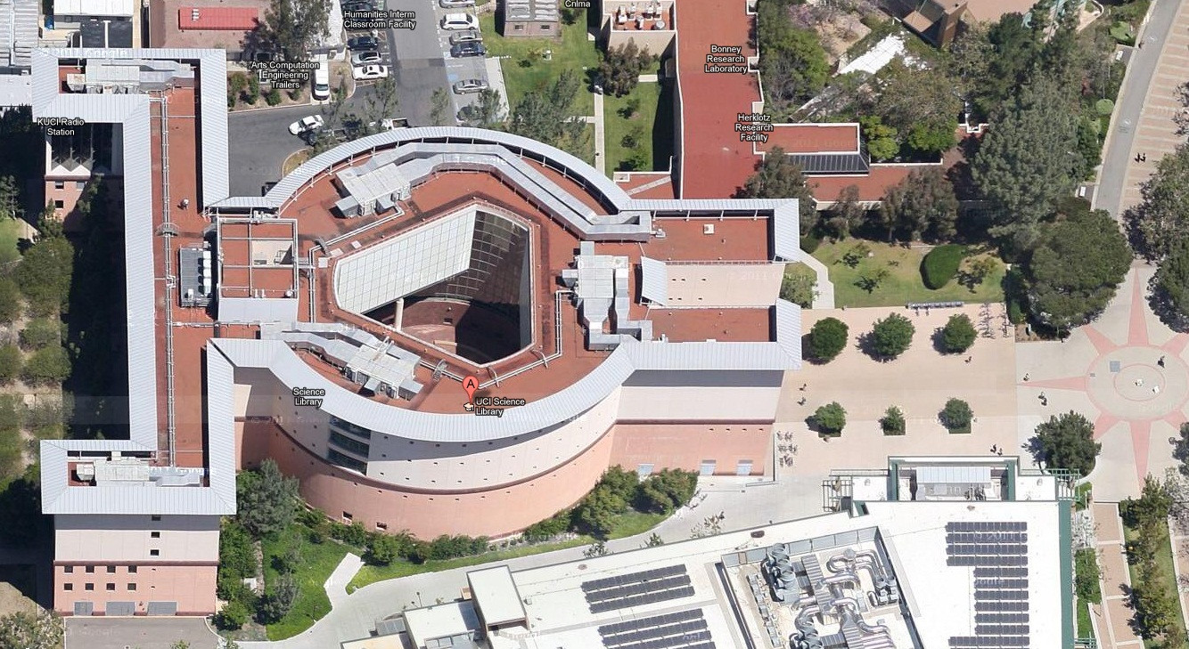
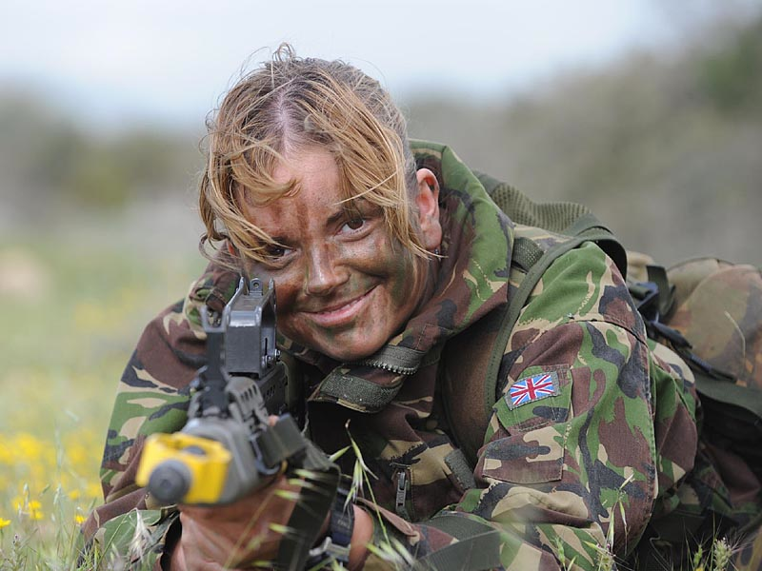
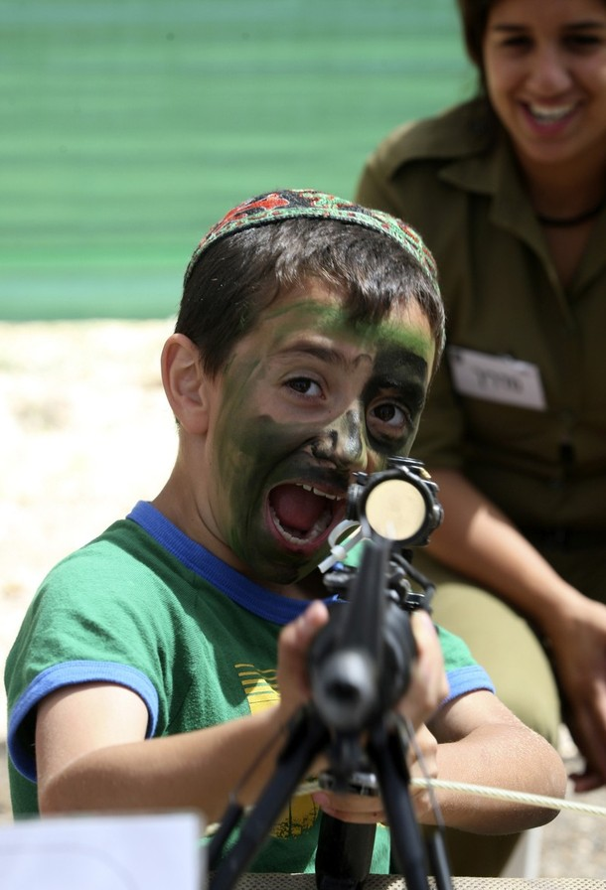
UCI Science Library

Slide 15
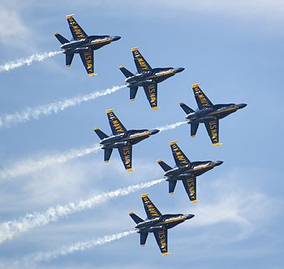
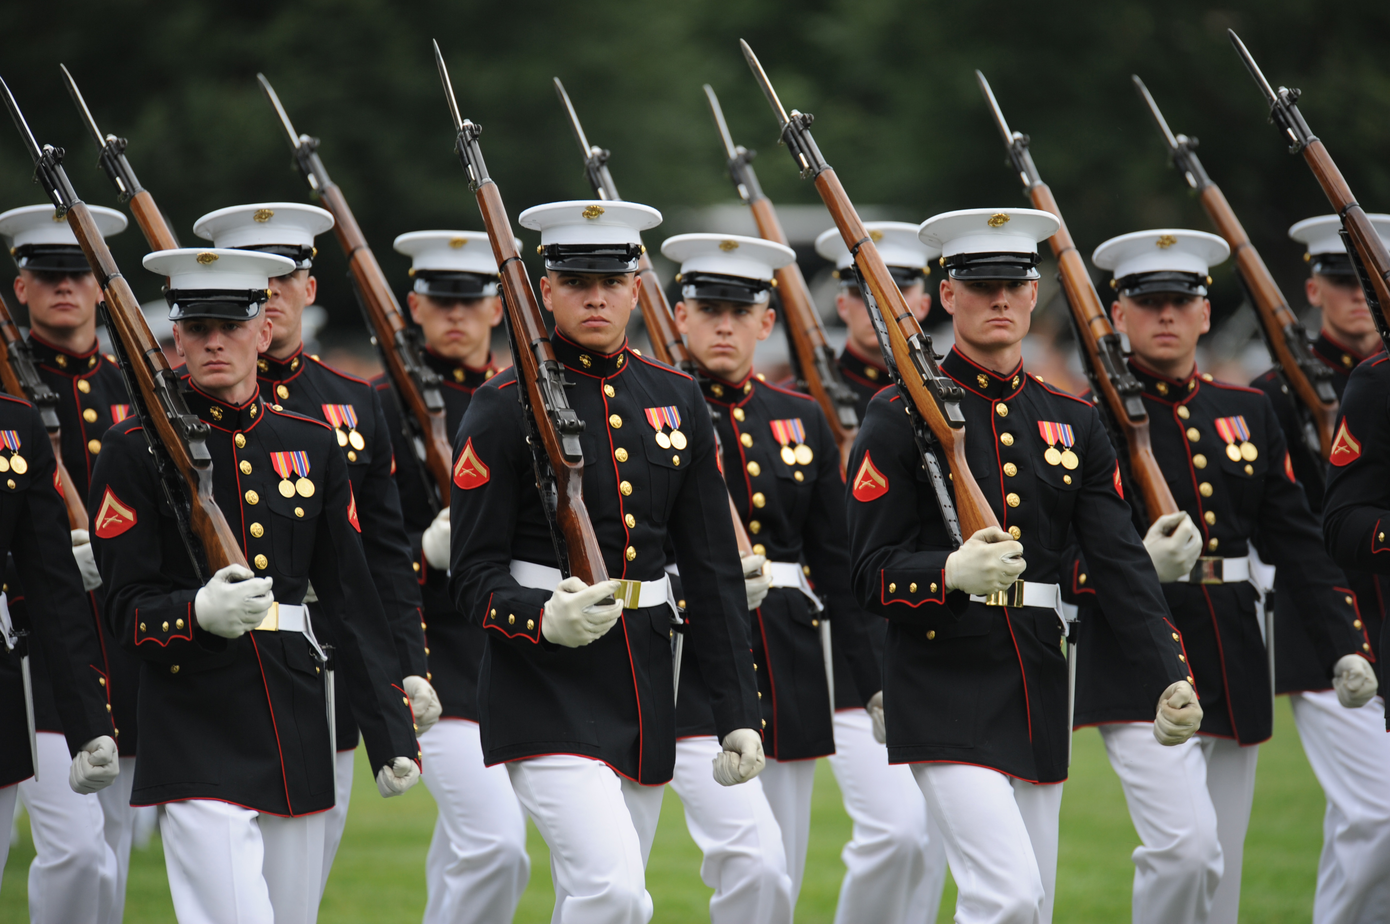

Slide 16
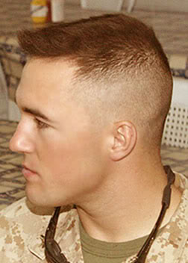

High-and-tight

Slide 17
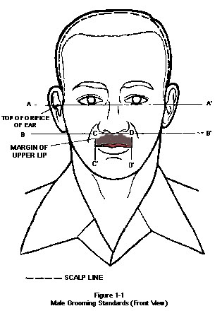
Proper grooming standards
“Males will keep their face clean-shaven when in uniform or in civilian clothes on duty. Mustaches are permitted; if worn, males will keep mustaches neatly trimmed, tapered, and tidy. Mustaches will not present a chopped off or bushy appearance, and no portion of the mustache will cover the upper lip line or will extend sideways beyond a vertical line drawn upward from the corners of the mouth.” (Army Reg 670-1 http://www.apd.army.mil/jw2/xmldemo/r670_1/head.asp

Slide 18
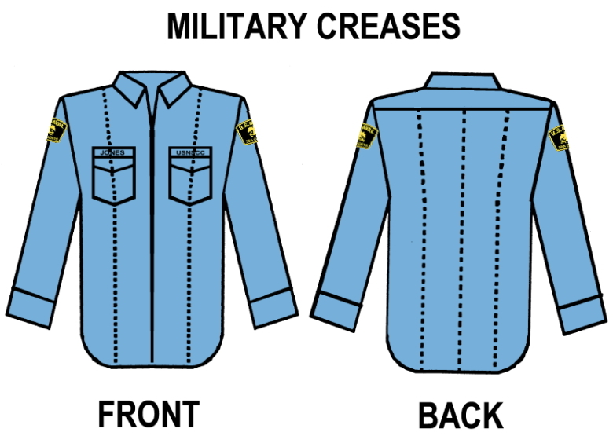
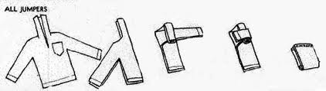

Slide 19
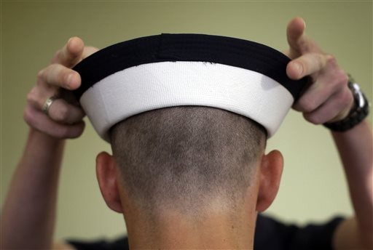
SPEECH

Slide 20
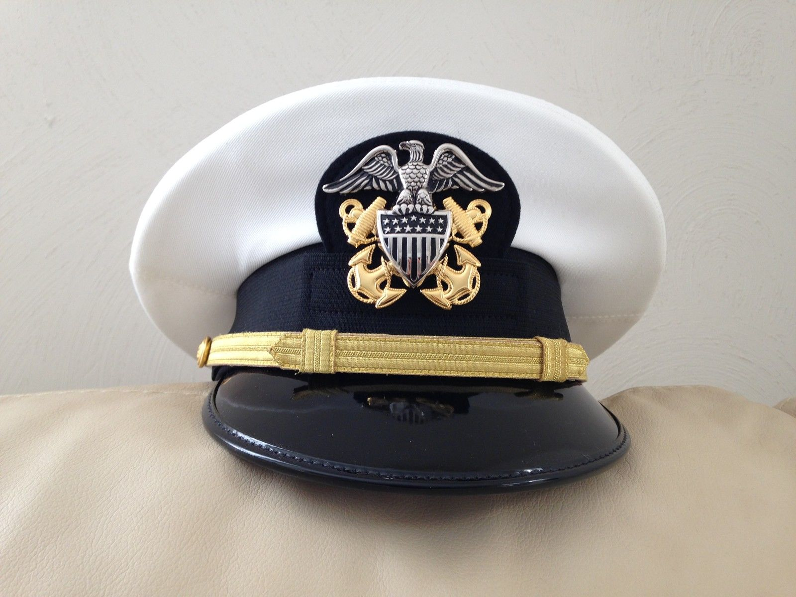

Slide 21
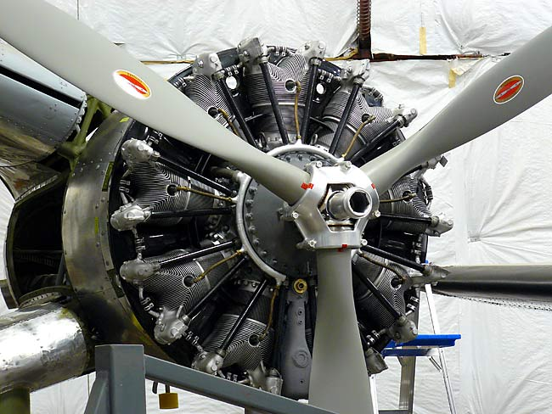

Slide 22
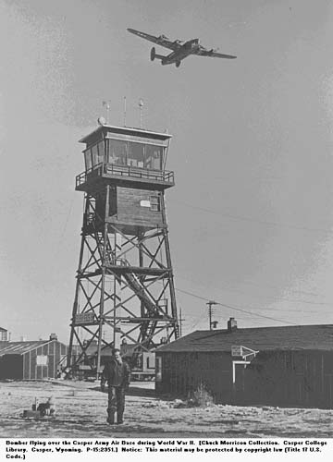
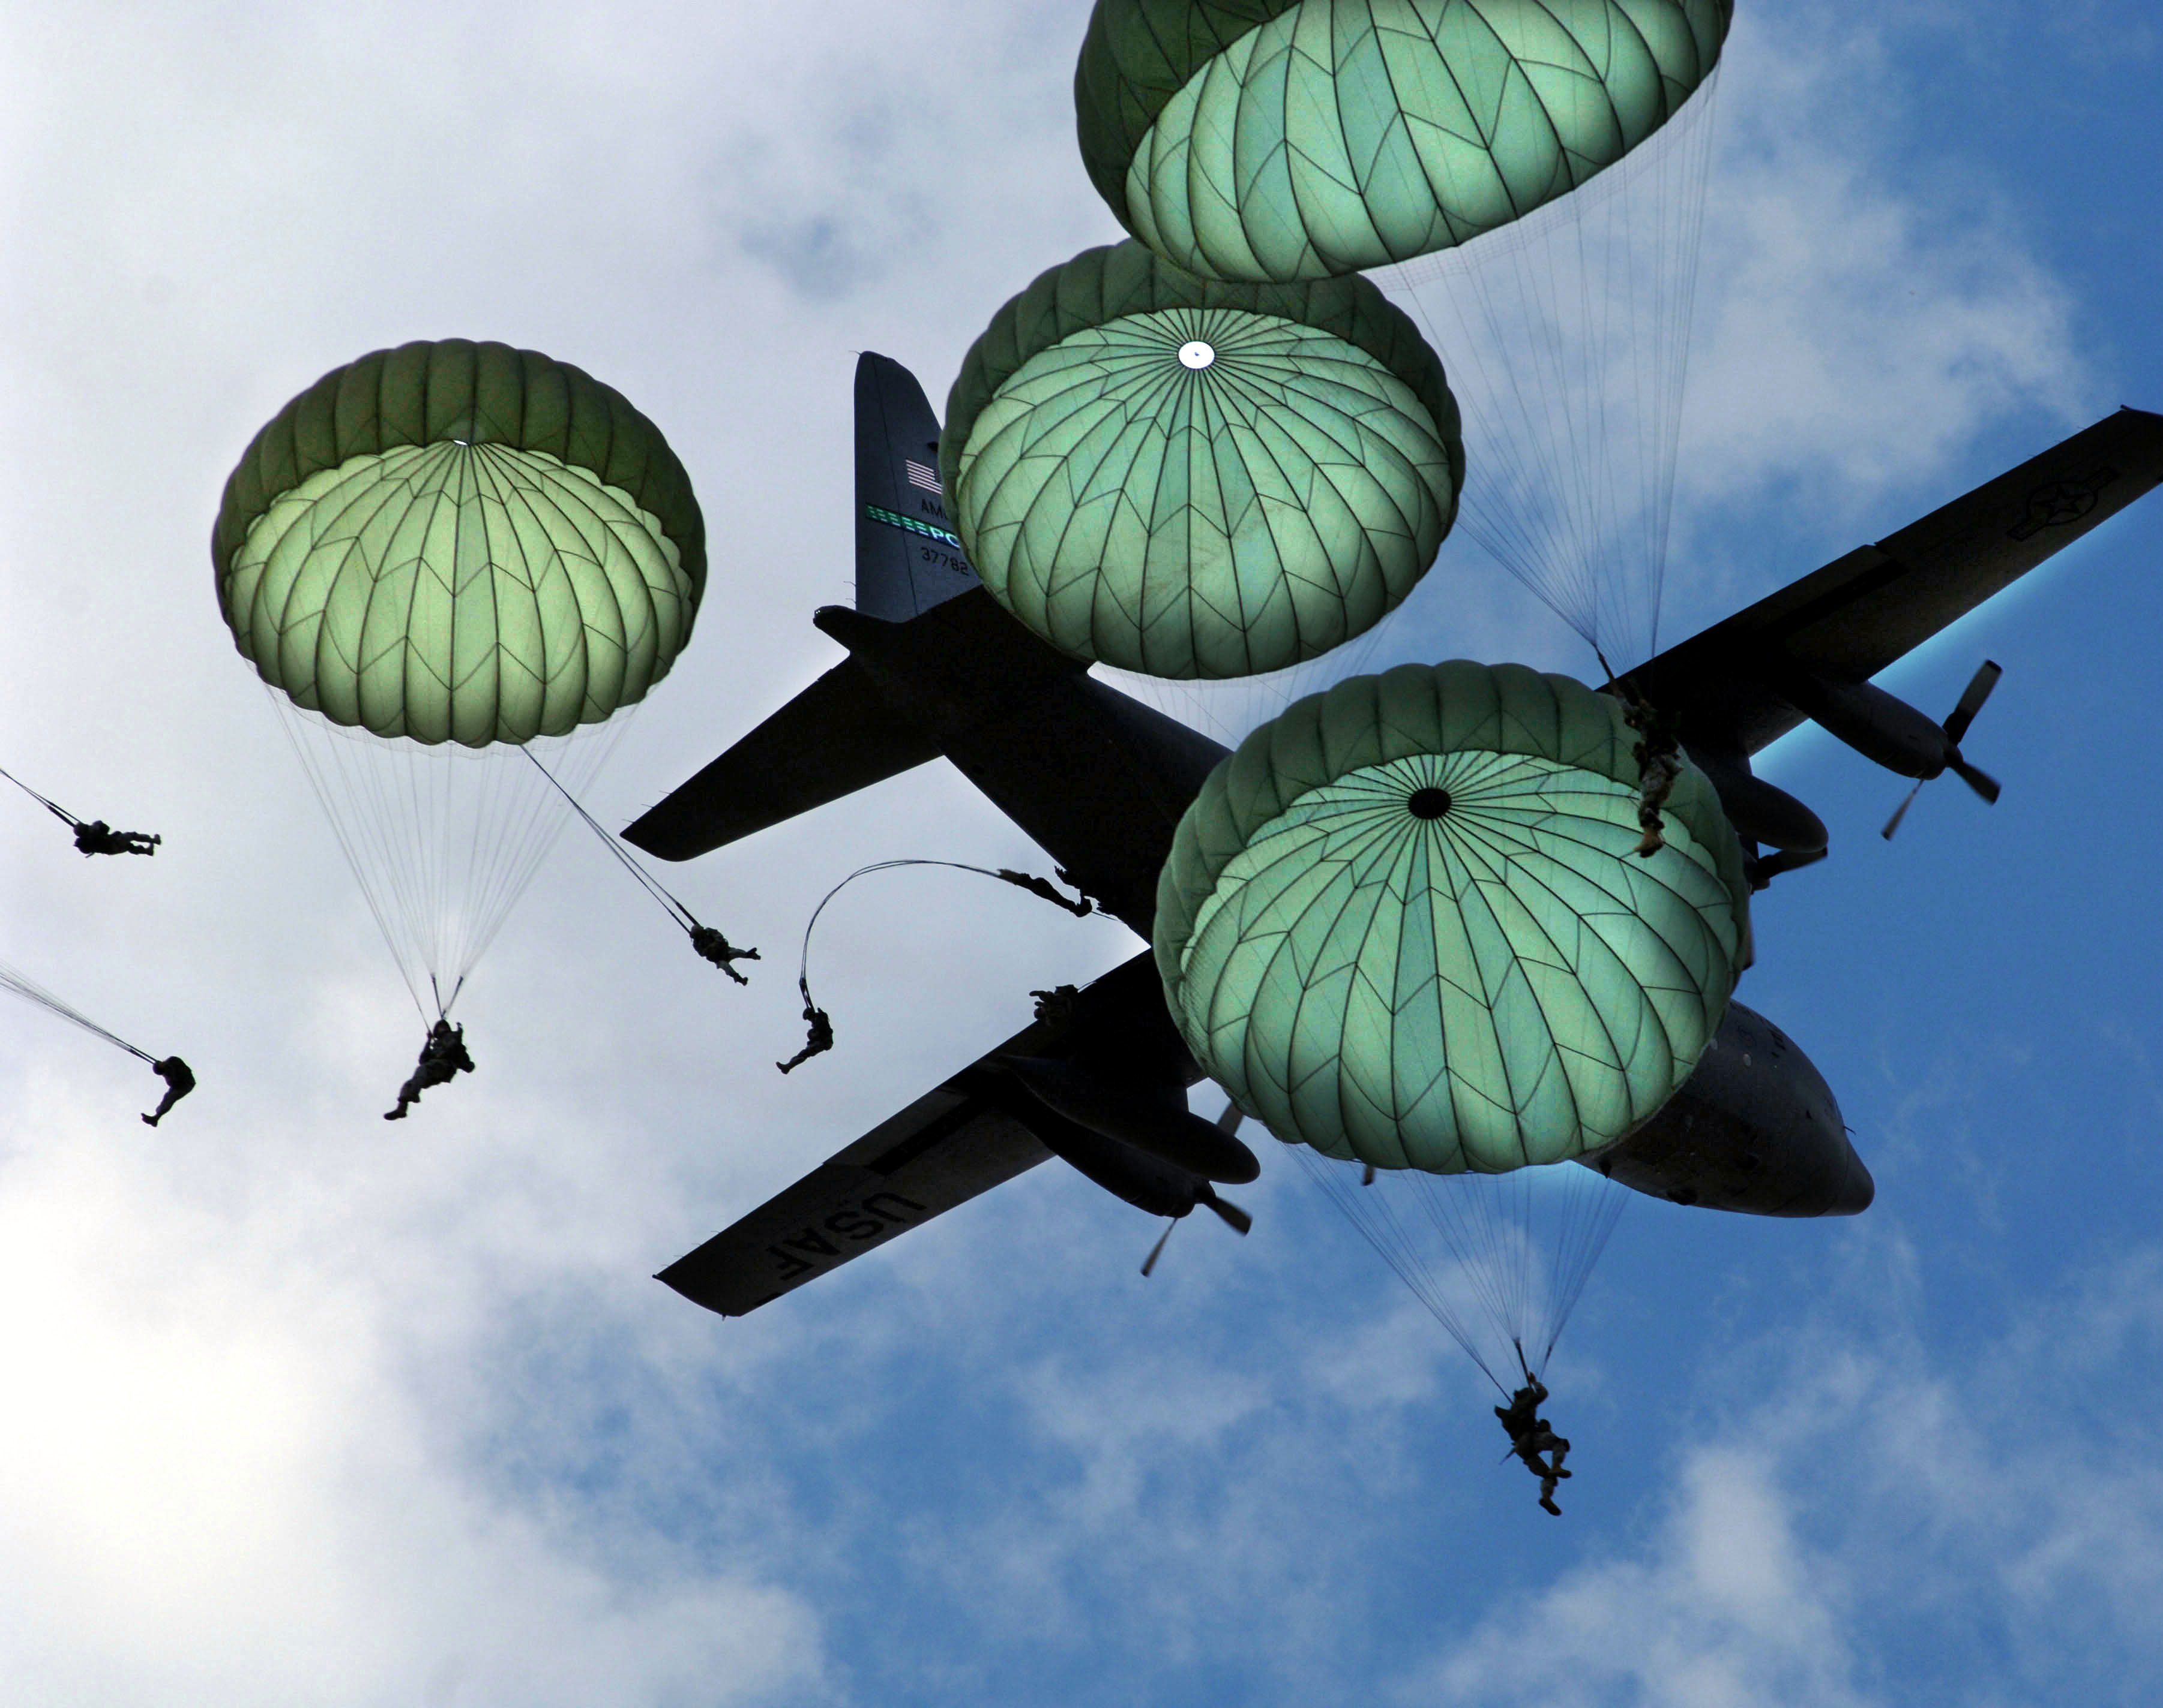
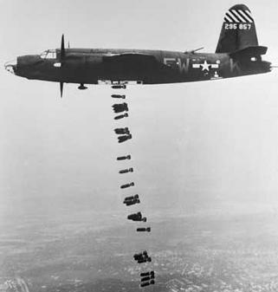
The Madhouse
Hanging out the laundry
Laying eggs

Slide 23
The Function of Military Folk Speech
Distinguish members of the corps from civilians
Lessen the tedium with humor
Release anxiety and tension
Safely complain
Express frustration with hierarchy
Indoctrination (also called “bastardization”)
By referring only to themselves in 3rd person, recruits shift their identity from an individual one to a collective one

Slide 24
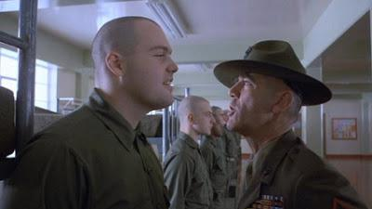
Leonard Lawrence (aka Pyle)

Slide 25
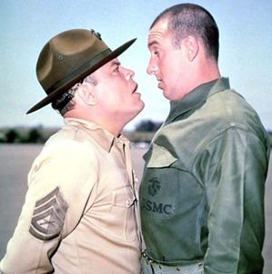
“Gomer Pyle USMC” (1964-69)
Starring Jim Nabors as Gomer and Frank Sutton as his Gunnery Sgt.

Slide 26
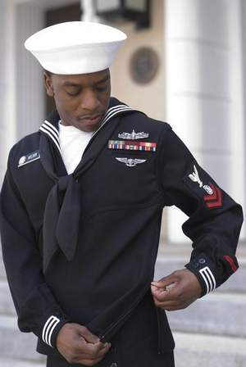
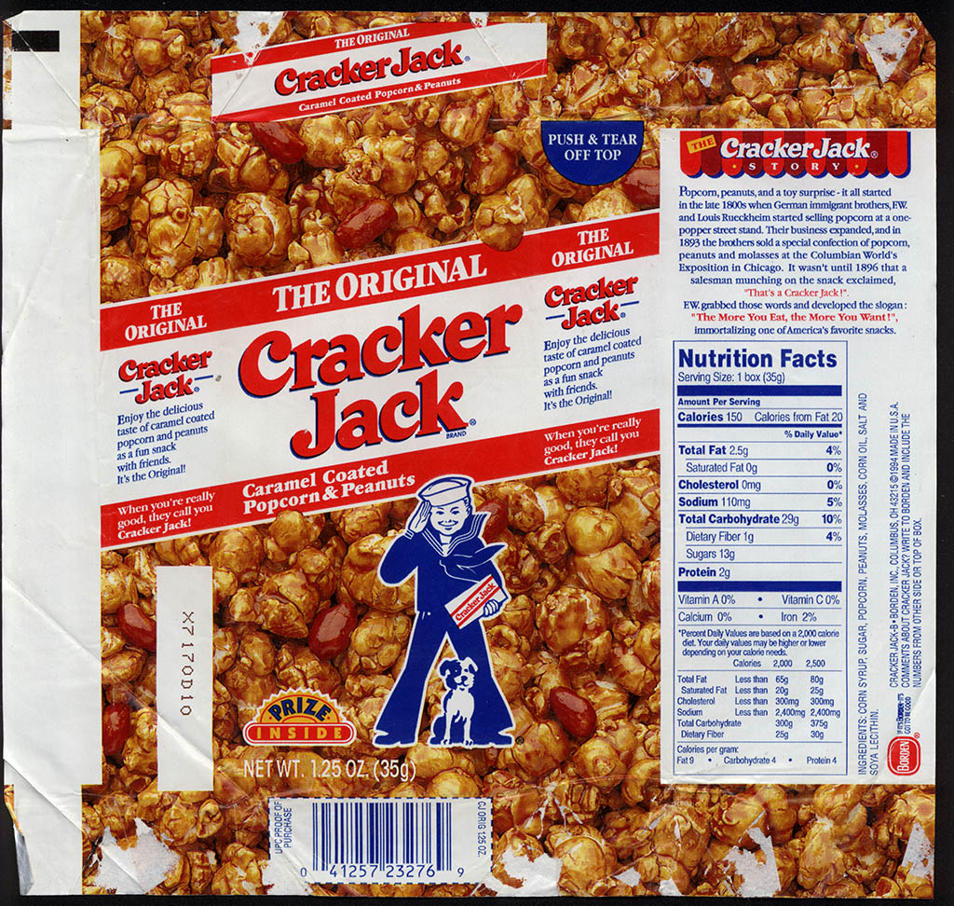

Slide 27
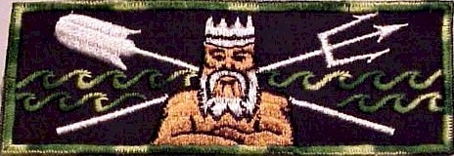
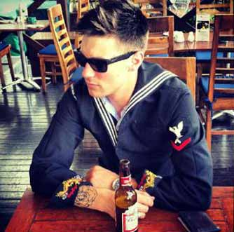
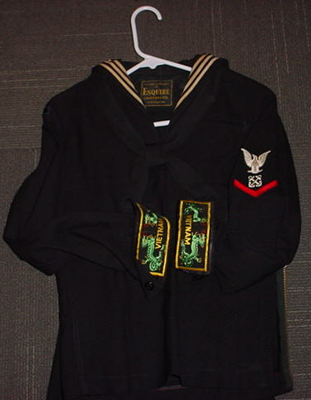

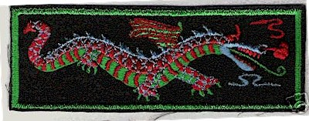
Liberty Cuffs

Slide 28
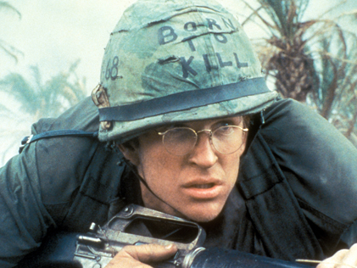
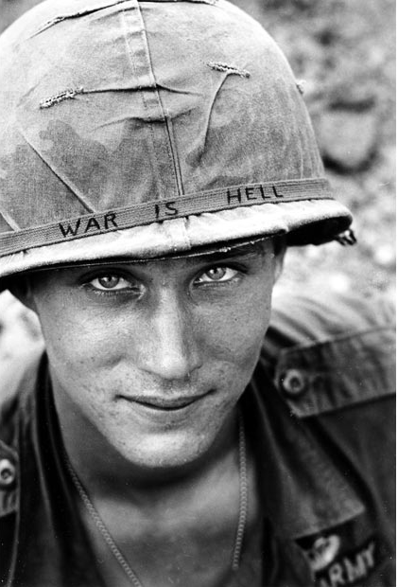

Slide 29
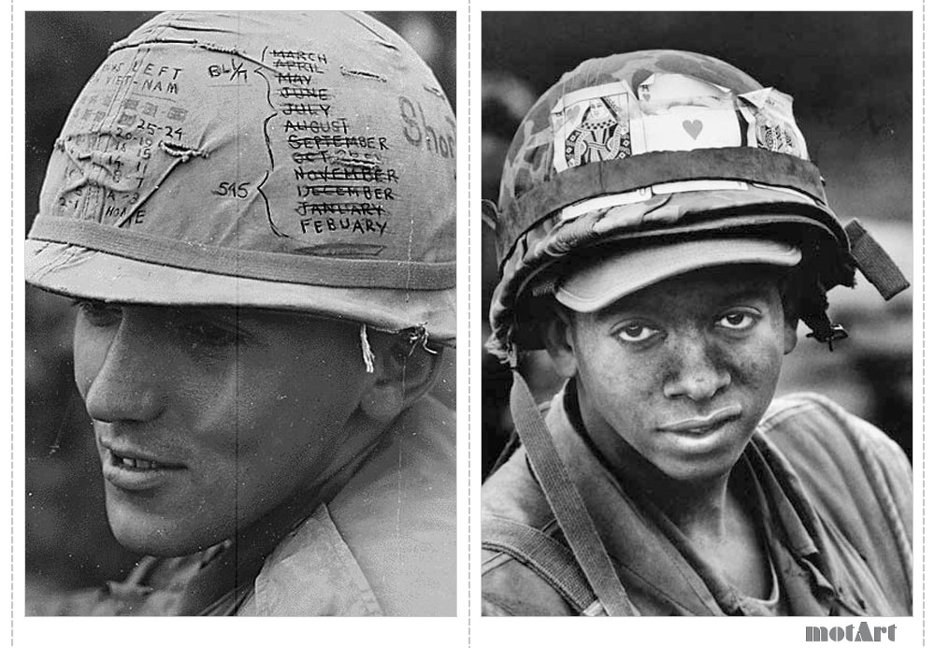
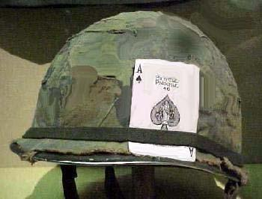
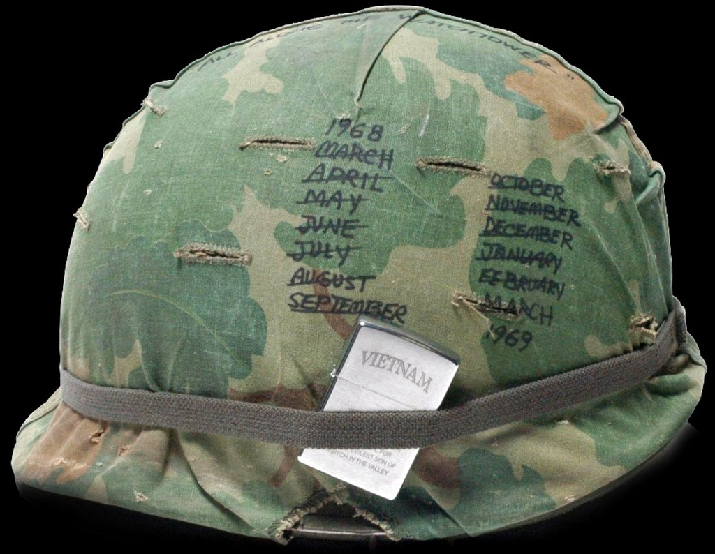

Slide 30
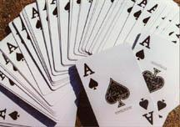
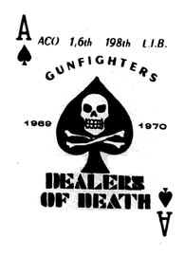

“the death card”

Slide 31


Short-timer Calendars

Slide 32


Slide 33


Slide 34

The short timer

Slide 35

Short timers
Gustav Hasford (1947-1993)
Kubrick based his film on Hasford’s Short Timers, published in 1979
Enlisted in the Marine Corps, and like Joker, was sent to Vietnam as a combat correspondent.
Of that job, he writes: “We appeared to be journalists, but we were really simply promoting the war and promoting the Marine Corps.” He goes on, “In war, truth is the first casualty….History may be written with blood and iron but it’s printed with ink.” (35)

Slide 36
Vietnam War Facts
1956 – 64 “Advisory Period of the War”
1965 – 1975
2.7 million Americans served in Vietnam (25% were draftees—in WWII it was 65%)
3.5 million Americans served in the greater S E Asian theater (Vietnam, Cambodia, Laos and Thailand)
1968 (Jan – Feb) Tet Offensive
58,202 American soldiers killed in the war
2-3 million Vietnamese killed in the war
6,727,000 tons of ordnance dropped on Indochina (compare with WWII – 1,633,000 tons)
3,500,000 acres sprayed with 19,000,000 gallons of defoliants
140,000 Vietnamese evacuated in April 1975
(http://www.va.gov/opa/publications/factsheets/fs_americas_wars.pdf)

Slide 37

What to look for in the film?
Kubrick is famous for his long takes.
Where is he placing these long takes and why?
He’s also known for his deep focus shots in which the background, middle ground and fore ground are all in focus.
Places where you see the real verging on the absurd
Why is the film called “Full Metal Jacket” and not “Short-timers?”

Slide 38




Military Tattoos

Slide 39


Brotherhood Tattoos

Slide 40


Ironic Tattoos
infidel

Slide 41



Memorial Tattoos

Slide 42


Meat Tags

Slide 43



Flesh Shreds

Slide 44





Flesh Shreds

